Slide 1
Integrating Drilling Info into Aries
The process, programs, and benefits.
Ancel Carson
8/8/2019
Notes:
@ Organize and automate different aspects of data collection.
@ Pulling information on all operated and non operated wells from Drilling Info.
@ Process of this automation, the programs used to complete this task, and the benefits of the automated system.

Slide 2
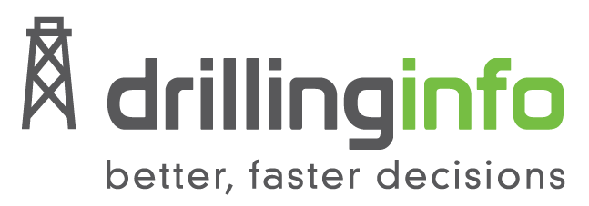


Process
Download
Filter
Import

Slide 3
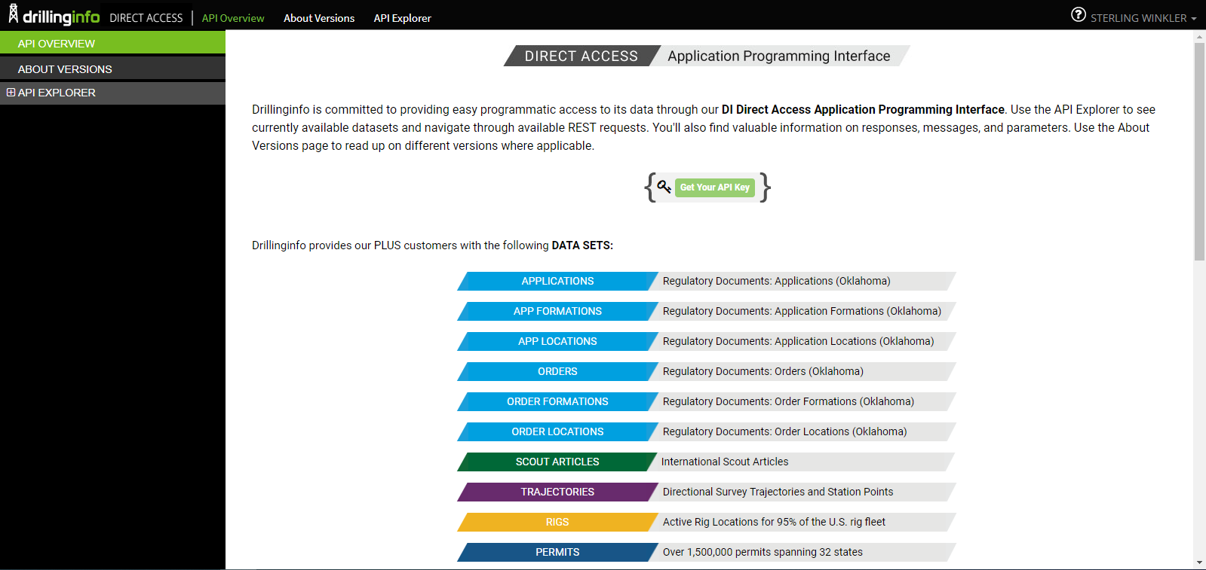
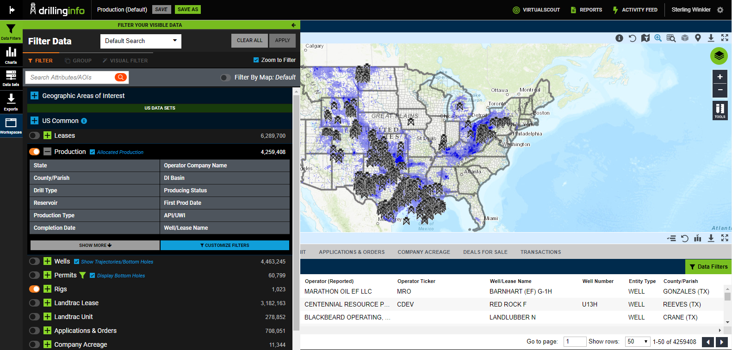
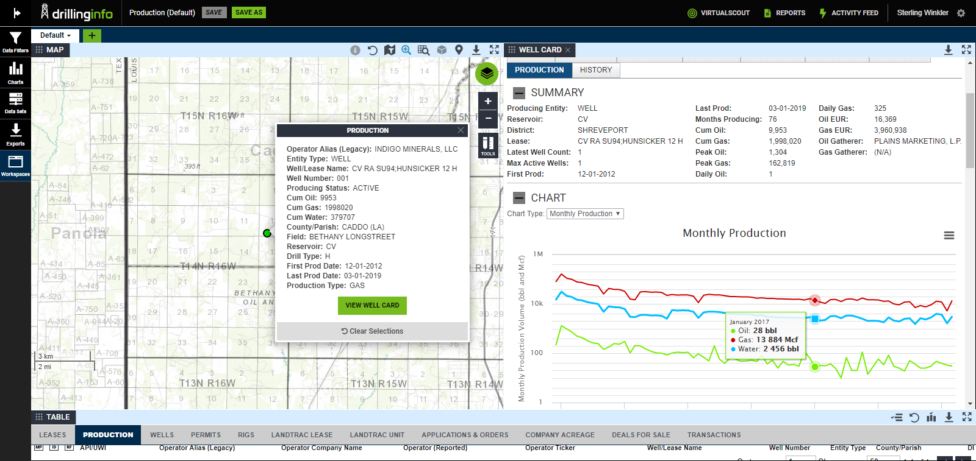
Notes:
Online database of all US wells. Filter by State, Basin, API #, Max Production etc.
Characteristic data: name, location, well type
Production Data: Tabular and graph
Direct Access: Backend used to connect to python. Direct to data

Slide 4
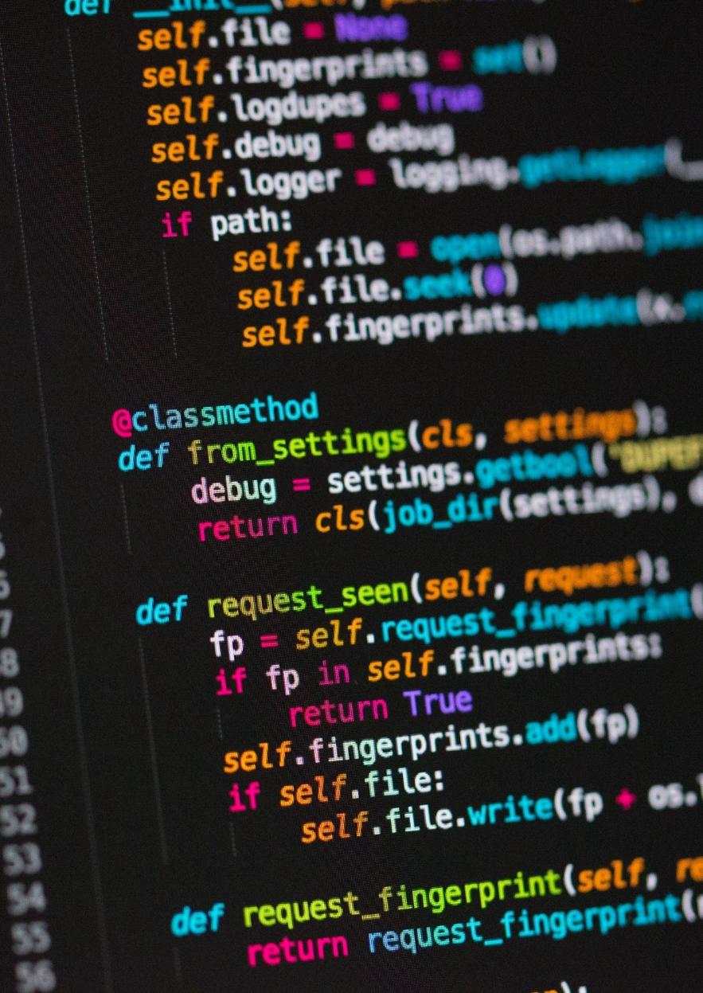
Powerful
Fast
Light Weight
Versatile
Widely used
Google
Industrial Light & Magic
YouTube
Drilling Info
Notes:
@ Powerful: Used for Big Data
@ Fast: Made to handle big data quickly
@ Light Weight: Flexible syntax, small files
@ versatile: connects to many different programs and can run different functions
@ Widely Used: ILM: CGI generation

Slide 5

Programs
Update Well Data
From Drilling Info
Characteristic data
Production data
Update Wells and Statuses
From internal records
Status for a new month
Records for new wells
VEFI Records
ARIES
Notes:
@ Data: Connect to DI, send APIs, production and describes well
@ status: Internal data, updating month, adding wells

Slide 6
Update well data UpdateDatabases.py
New API Collection
Status update
Production update
Collecting new APIs
Downloading data
Adding to Database
Collecting all APIs
Downloading Data
Adding to Database
Collecting all APIs
Downloading data
Filtering out records
Adding to database
ARIES
Notes:
@ Similar processes with variations between them
@ First: All characteristic data for new wells
@ Second: Certain fields for all wells. Ones that may change
@ Third: All production all wells, filtered

Slide 7
Update Status StatusUpdate.py
Pulling information from Accounting
Step by step instruction
Quick processing through excel
Syncing between Access and SQL
VEFI Records
ARIES
Notes:
@ Works with internal data
@ Step by step instruction
@ Open applications but handle in background
@ Use excel to help order and move to Access
@ Sync all with SQL

Slide 8
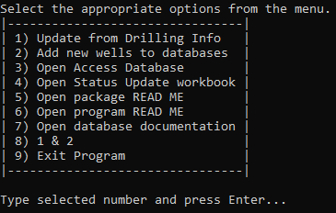
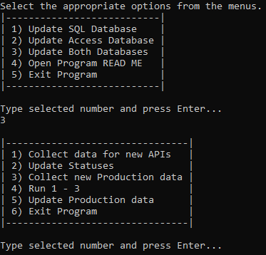
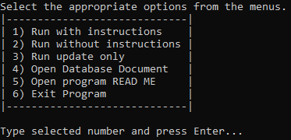
All programs and Modules
Database Control.py
UpdateDatabase.py
StatusUpdate.py
LoginCredentials.py
Notes:
@ Control directs other programs
@ Login: Easy to alter, used by all programs, easy to keep passwords separate
@ Simple interfaces, select number, enter

Slide 9
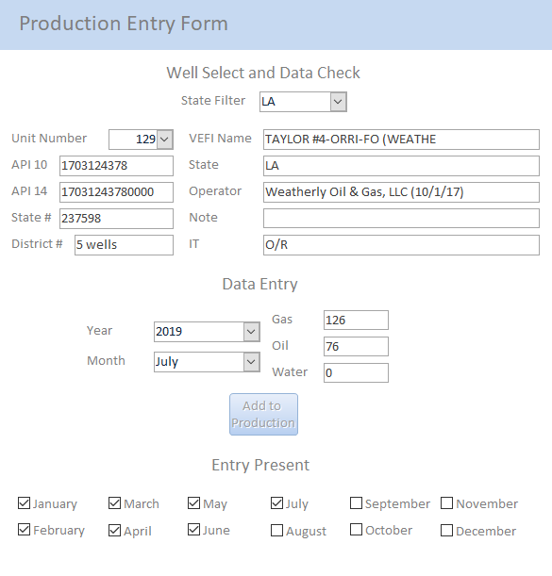
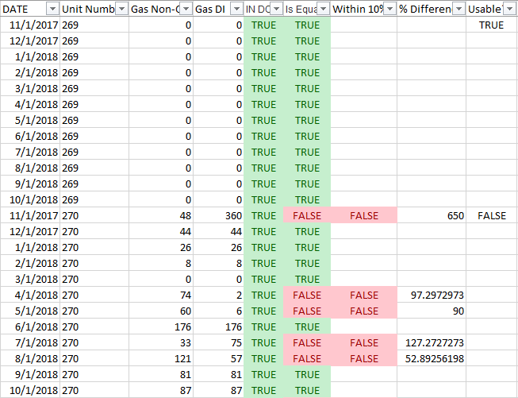
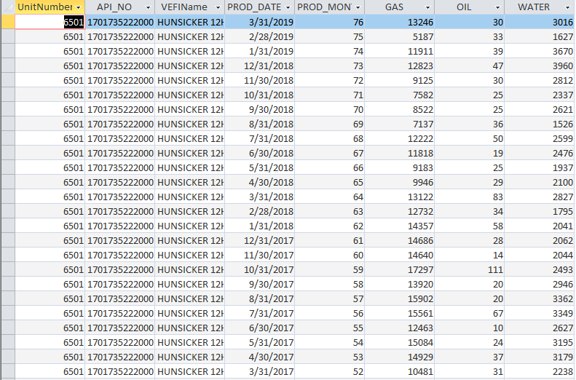
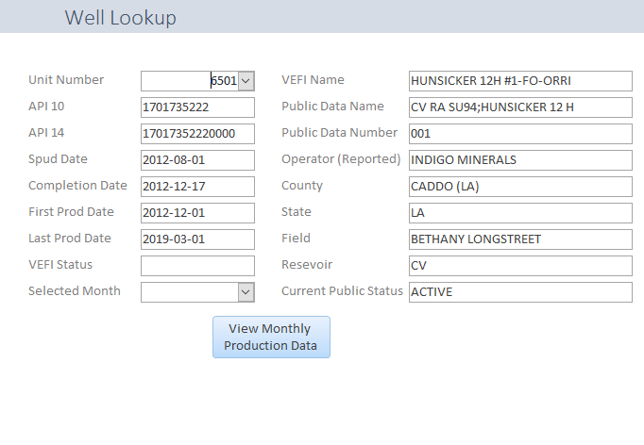
END Result
Visualized in Access
Quick look at useful data
Quickly pull production data
Ease of manual entry
Notes:
@ Easier to view in Access
Quick results, easier to read, not tabular form, select by well
Press button, all production for well
Entering manual data, filter by state, change unit list, select year and month, add record, boxes update, no duplicates
Some wells not accurate enough, compared years worth, within 10%, reduce by 75%

Slide 10
Why use this? Current method
Production for over 1000 wells manually entered from various sources
Production techs spend hours on this monthly
Data gathered from:
State production databases
Sales Ledgers
Revenue Statements
Notes:
@ Need to compare current method with new
* Sterling*

Slide 11
Why use this? New method
Run the program
Select from the menu
Return when program is over

Slide 12
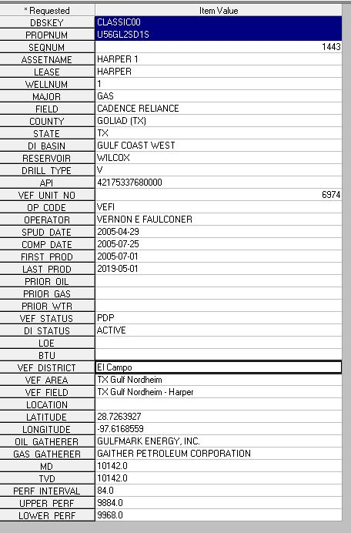
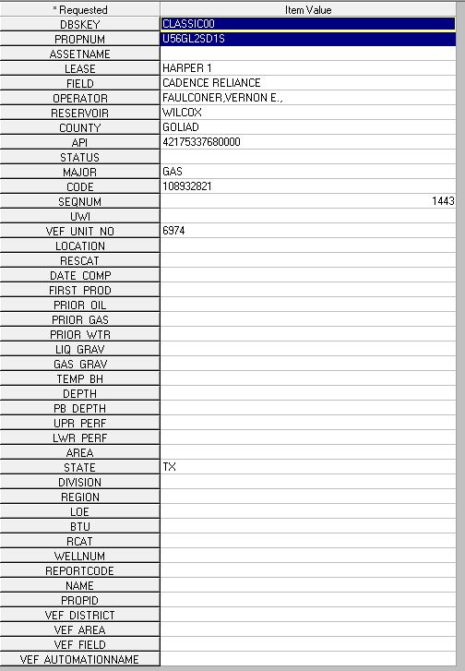
Why use this? Benefits
Reduces time
Removes a potential layer of errors
Runs complex calculations
Data directly from production reported to state
More diverse data
Notes:
@ reduces time, total and interactive
@ Less typos
@ Filter and sort
@ DI draws from state
B) Currently lacking in ARIES Master
C) More data in built Master

Slide 13
Presentation Break
Questions on the program?
Notes:
@ Separate presentation and Internship discussion

Slide 14
What did the intern do? Building this system
Collecting excel files
Compiling data
Sifting through APIs
Creating databases
Writing programs
Excel
Access

Slide 15
What did the intern do? Additional Projects
SPCC Spill Plan Inventory
Production Target Rates

Slide 16
What did the intern Learn? Takeaways
Better understanding of Oil & Gas
A look into a different field
Chance to use different skills
Practice in learning new systems on the spot
Tools to take back to school and into a future career

Slide 17
Resources
https://app.drillinginfo.com/production/
https://info.drillinginfo.com/
https://www.python.org/
https://towardsdatascience.com/python-virtual-environments-made-easy-fe0c603fe601

